Slide 1
WHO BUILDS THE FUTURE?
Workshop about Future-Focused Career Pathways
2025

Slide 2
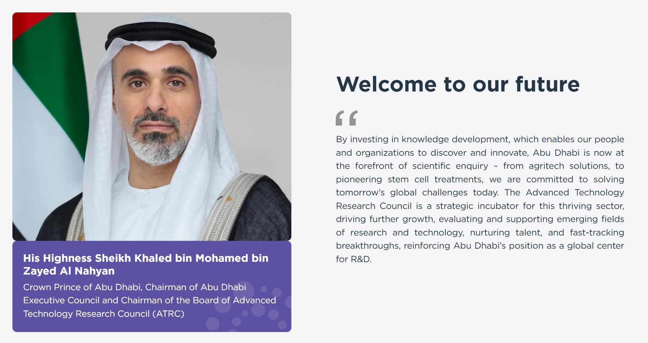
WELCOME TO OUR FUTURE!
This workshop is brought to you by ATRC – Advanced Technology Research Council
ATRC is a government entity developing Abu Dhabi
as a global center for Research and Development
(R&D)
ATRC.GOV.AE
ATRC.GOV.AE/FFCP
Notes:
Welcome to this interactive workshop brought to you by ATRC.
Be active and enjoy! Share your thoughts and ideas boldly, actively discuss, and it will be fun!

Slide 3
WHAT ARE YOUR FAVORITE TECHNOLOGIES?
Notes:
INTERACTIVE: SAY OUT LOUD
Let’s get interactive! What technology excites you most? Is it AI, robotics, gaming, or something else?
Take a minute to think, and then share with the person next to you.
We’ll hear some of your ideas.

Slide 4

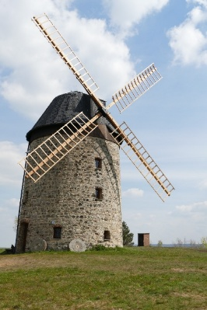



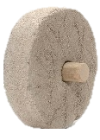
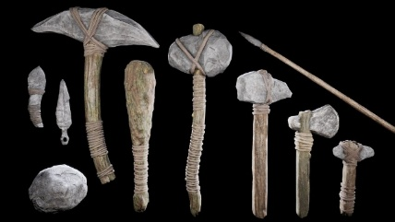
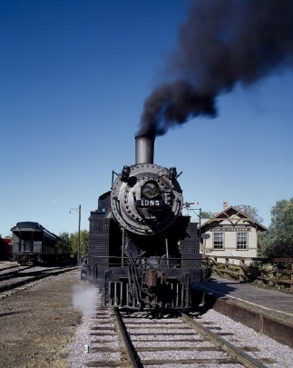
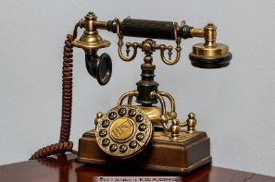
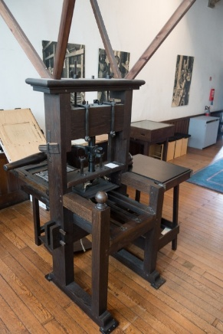

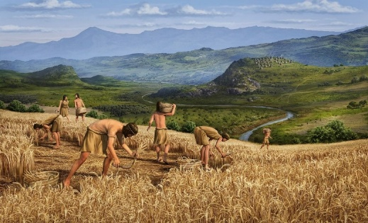
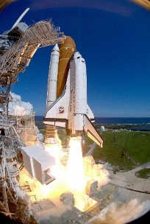
HOW TECHNOLOGIES DEVELOPED ACROSS CENTURIES
Ancient Technologies
Medieval Innovations
Industrial and Space
Watermill
Steel
Electricity
Steam Engine & Railroads
Windmill
Printing Press
Agriculture
Space shuttle
Notes:
INTERACTIVE: GUESS GAME
Let’s take a quick time-travel journey! Let’s remember how technologies developed throughout history. Name the time period and what technologies existed in that time.
What ancient technologies do you know? (Pictures: fire, wheel, tools (hammer, spear, cudgel), agriculture)
What era came next? Medieval – it was the time when humanity created powerful machines that used mechanical power, so that people could apply less physical effort and gain more results! Pictures: windmill, watermill, printing press, clock. These innovations boosted agricultural productivity and supported urban growth, democratized access to knowledge, fueling literacy. These technologies laid the groundwork for future industrial automation.
What era comes next? Right – Industrial and Space era. Steel allowed mass construction of skyscrapers and durable machines; Steam engine and railroads powered factories and locomotives, allowing mass production and long-distance trade; Electricity enabled electric motors and assembly lines, reducing human effort and increasing precision, and lighted our homes. Space-age technology enabled unmanned probes, satellite networks, and remote sensing, reducing human presence in hazardous environments. Telephones made people more connected.
Imagine how different life throughout these eras looked like. Imagine yourself living with these technologies.

Slide 5
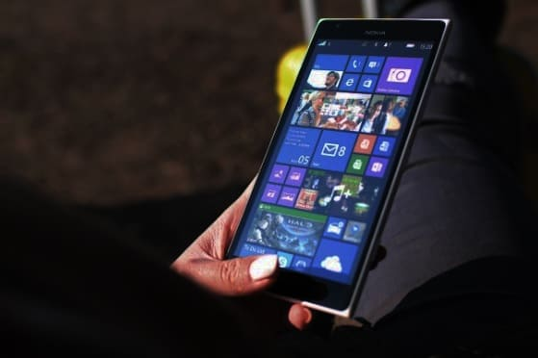
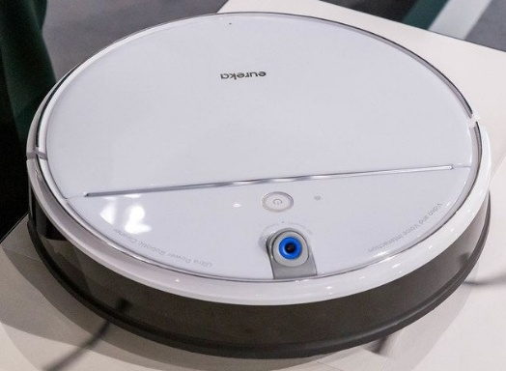
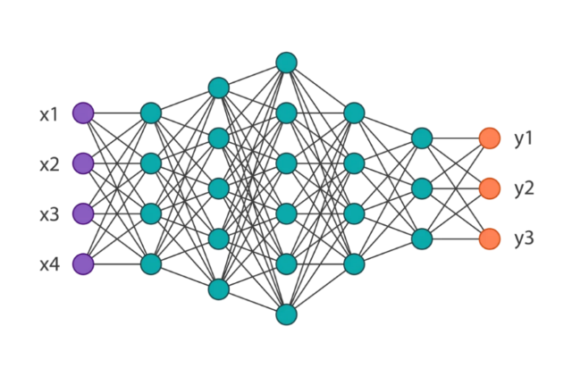
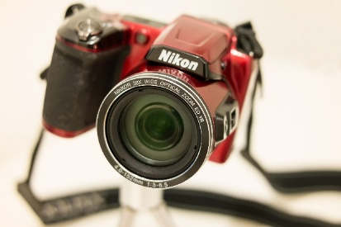


HOW TECHNOLOGIES DEVELOPED & THE FUTURE OF TECHNOLOGIES
Digital Age
Intelligence Age
Neural Network
AI
What else?
Notes:
INTERACTIVE: GUESS GAME
What came next? Digital Age.
Phones, Internet, Cameras, Laptops, Smartphones. All these technologies are based on earlier technologies – they need electricity. Most future technologies are built on the technologies of the past.
And now, since the release of ChatGPT in 2023, we entered the Age of Intelligence. It just started, and the key technology is Artificial Intelligence. AI existed before 2023, but it became truly intelligent with Generative AI – technology based on Neural Networks. Neural Networks allow machines to “think like a human”.

Slide 6

HOW HAS TECHNOLOGY CHANGED THE CAREERS YOUR PARENTS OR GRANDPARENTS HAD?
Discuss in pairs, and then share with the class
5 min
Notes:
INTERACTIVE: DISCUSSION IN PAIRS / GROUPS
HOW HAS TECHNOLOGY CHANGED THE CAREERS YOUR PARENTS OR GRANDPARENTS HAD?
Discuss and share with the class.

Slide 7
  Technology is woven into our daily life, from smart devices at home to digital tools at work
  Technologies are everywhere:
  Construction
  Agriculture
  Food production
  Transport
  Education
  And more…
  Technologies transform
  how we
  live,
  learn,
  and work
Notes:
As you could see, technology is woven into our daily life, from smart devices at home to digital tools at work.
Technologies transform how we live, learn, and work.
Imagine how different life throughout different technological eras looked like. Imagine yourself living with these technologies.

Slide 8
How people in the past imagined the future?
Guess the technologies in the next pictures
Notes:
People always imagined how future technologies would look like.
Let’s take a look at the paintings from the past on how people in 20th Century imagined technologies of the future.
I will show you the picture, and you should guess the technology.
Do not be shy ☺

Slide 9
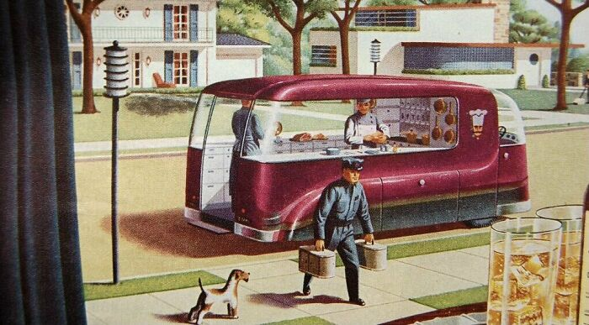
1940s vision of Food Delivery Technology
Notes:
INTERACTIVE: GUESS GAME
(You first show the picture only, and then click – and the answer appears on the slide)
What Technology is it? Tell it to the class. Don’t be shy ☺

Slide 10
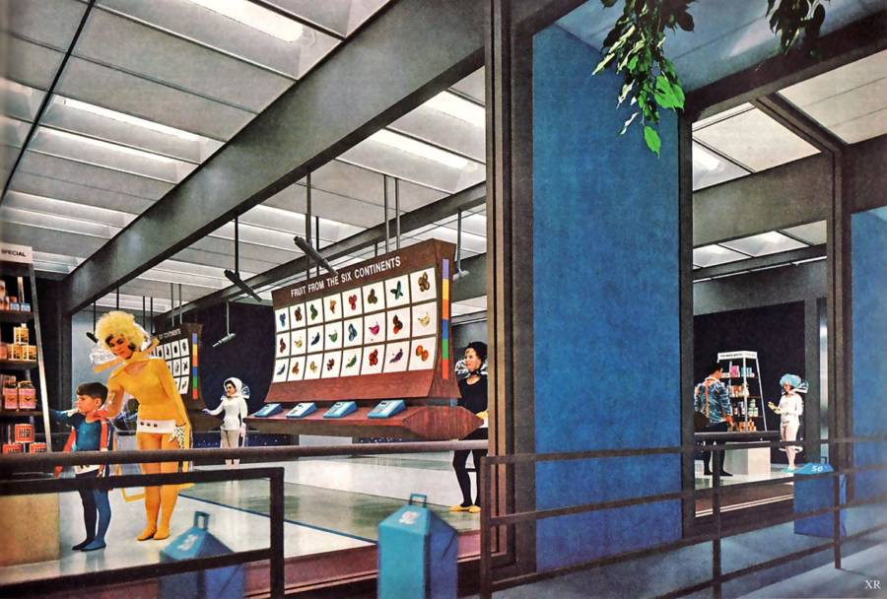
Shopping in the future
1965.
Notes:
INTERACTIVE: GUESS GAME
(You first show the picture only, and then click – and the answer appears on the slide)
What Technology is it? Tell it to the class. Don’t be shy ☺

Slide 11
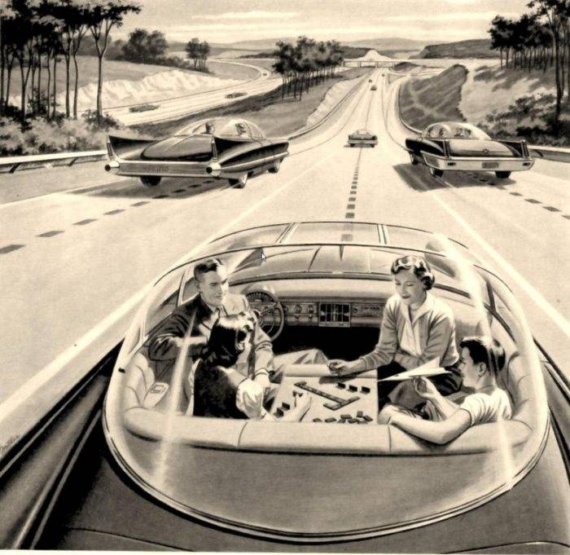
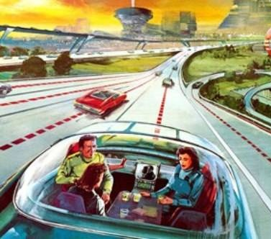
Self-driving car
1950s.
Notes:
INTERACTIVE: GUESS GAME
(You first show the picture only, and then click – and the answer appears on the slide)
What Technology is it? Tell it to the class. Don’t be shy ☺

Slide 12
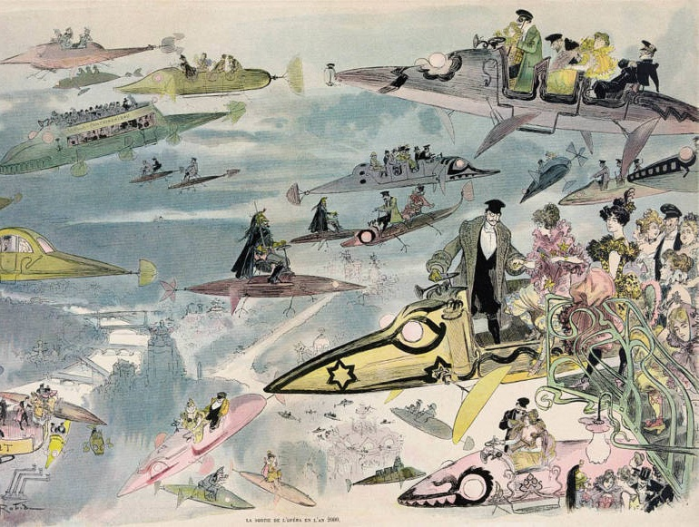
Air travel over Paris in the year 2000 as people leave the opera
Albert Robida
1882.
Notes:
INTERACTIVE: GUESS GAME
(You first show the picture only, and then click – and the answer appears on the slide)
What Technology is it? Tell it to the class. Don’t be shy ☺

Slide 13
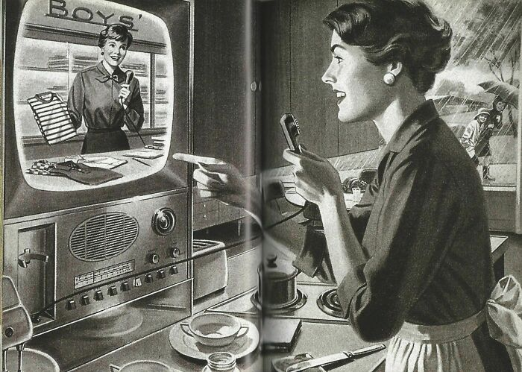
Home shopping in
1940s.
Notes:
INTERACTIVE: GUESS GAME
(You first show the picture only, and then click – and the answer appears on the slide)
What Technology is it? Tell it to the class. Don’t be shy ☺

Slide 14
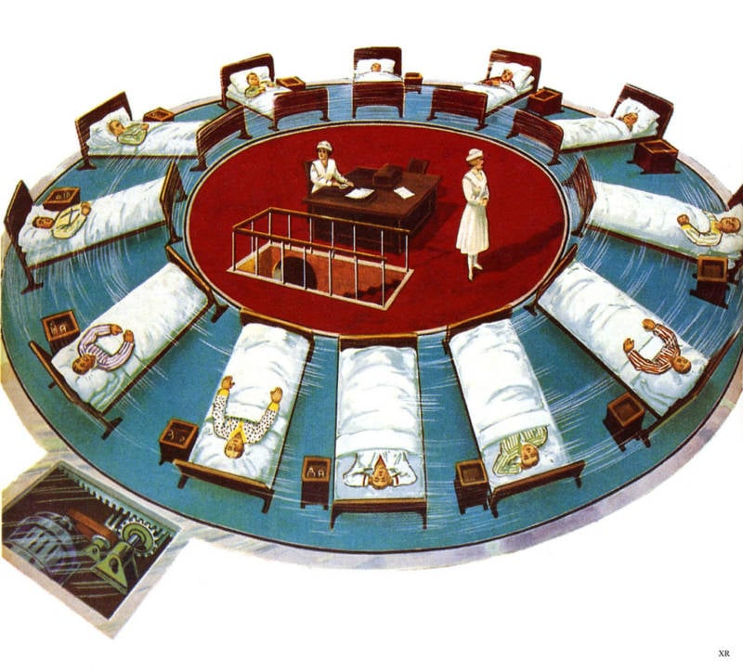
Centrifugal force rejuvenation or a reverse-aging process.
1935.
Notes:
INTERACTIVE: GUESS GAME
(You first show the picture only, and then click – and the answer appears on the slide)
What Technology is it? Tell it to the class. Don’t be shy ☺

Slide 15
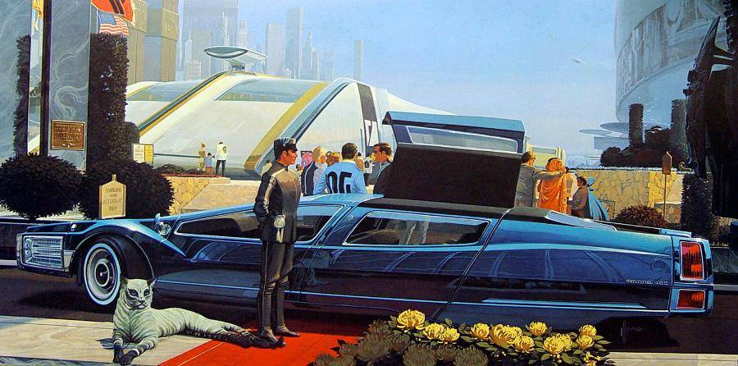
A futuristic limo with butterfly doors
Notes:
INTERACTIVE: GUESS GAME
(You first show the picture only, and then click – and the answer appears on the slide)
What Technology is it? Tell it to the class. Don’t be shy ☺

Slide 16

An underwater home
Artwork: Charles Schridde
1961–63.
Notes:
INTERACTIVE: GUESS GAME
(You first show the picture only, and then click – and the answer appears on the slide)
What Technology is it? Tell it to the class. Don’t be shy ☺

Slide 17
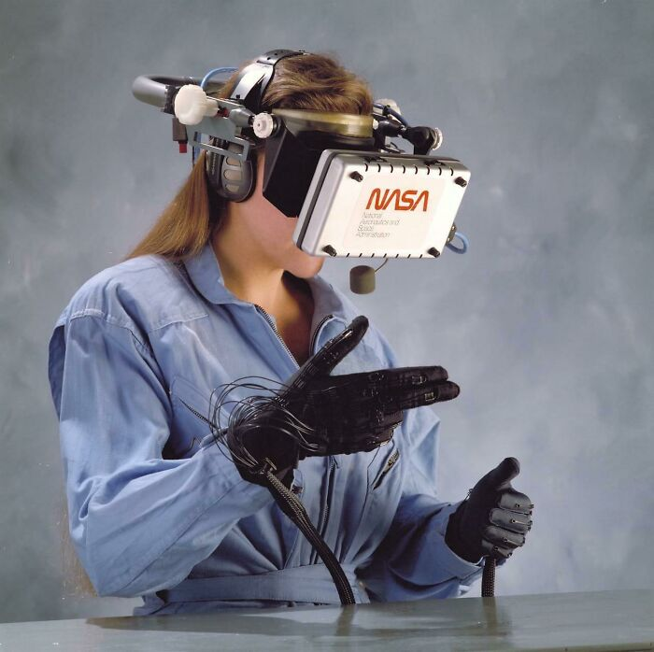
VR
1989
Notes:
INTERACTIVE: GUESS GAME
(You first show the picture only, and then click – and the answer appears on the slide)
What Technology is it? Tell it to the class. Don’t be shy ☺

Slide 18
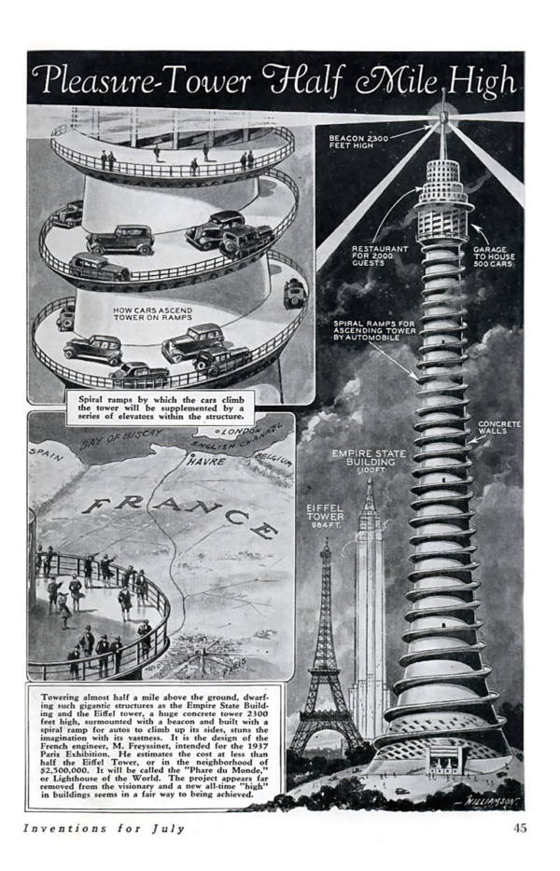
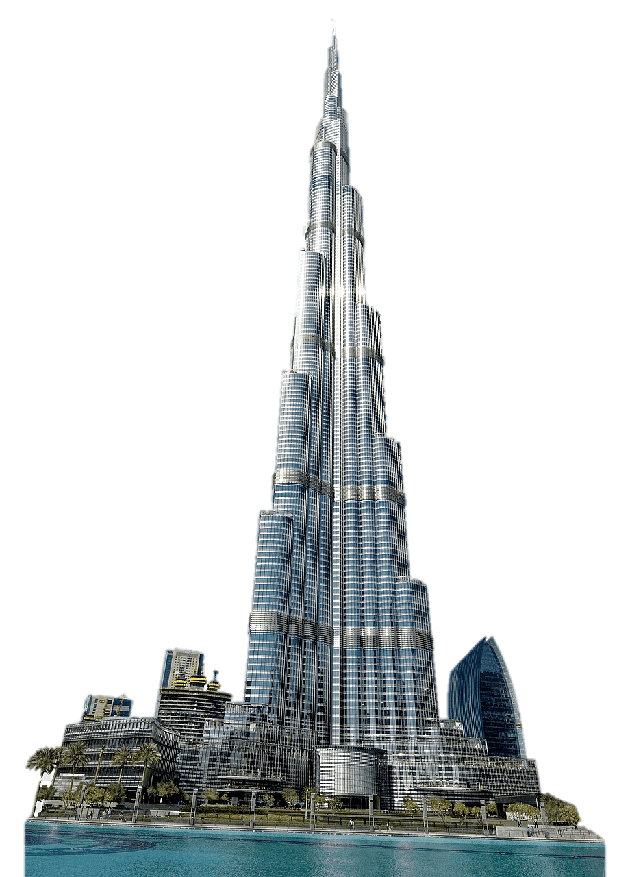
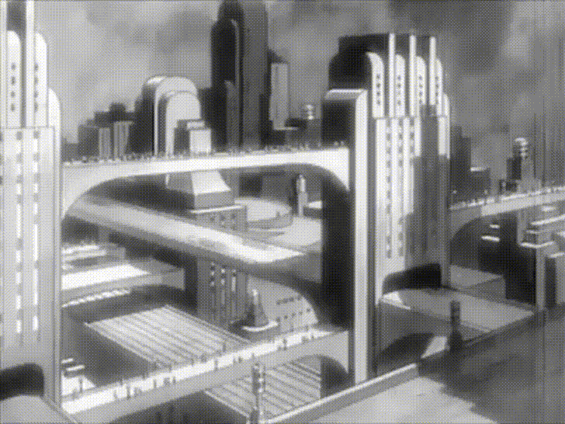
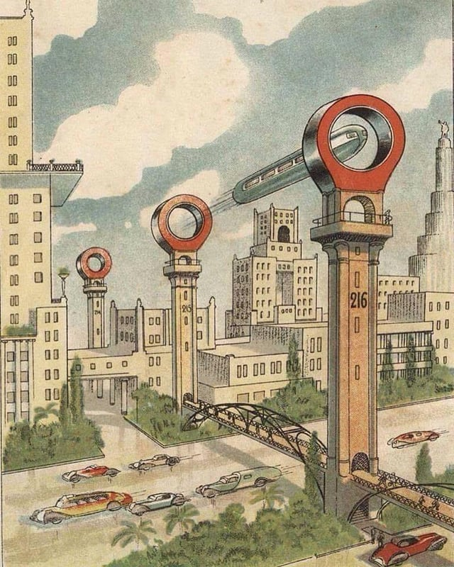
The half-mile-high pleasure tower with a restaurant and a 500-car garage. 1933
The city of the future from 1930s
Half-mile = 805 meters
Burj Khalifa = 829 meters
How many parking spaces and restaurants does
Burj Khalifa have?
3,000 parking spaces
10+ restaurants
Notes:
INTERACTIVE: GUESS GAME
(You first show the picture only, and then click – and the answer appears on the slide. After that you ask what this technology looks like – and someone should say Burj Khalifa – then you continue)
What Technology is it? Tell it to the class. Don’t be shy ☺
Does this tower remind you of something? Yes, Burj Khalifa!
But this tower is even lower – half-mile is 805 meters, and Burj Khalifa is 829 meters!
People imagined it to have 500-car garage and a restaurant. How many parking spaces and restaurants does Burj Khalifa have? LET STUDENTS GUESS – CLICK
Burj Khalifa has 3,000 parking spaces and 10+ restaurants

Slide 19
LET’S IMAGINE THE FUTURE
Split into groups of 4 people + AI
How the best future looks like?
What technologies are there?
Discuss
Describe
Your day in 2035 – how you wake up, work, play, learn, and meet friends
Present
Your group’s desired future & a day in life
10 minutes
Notes:
INTERACTIVE: GROUP WORK

Slide 20
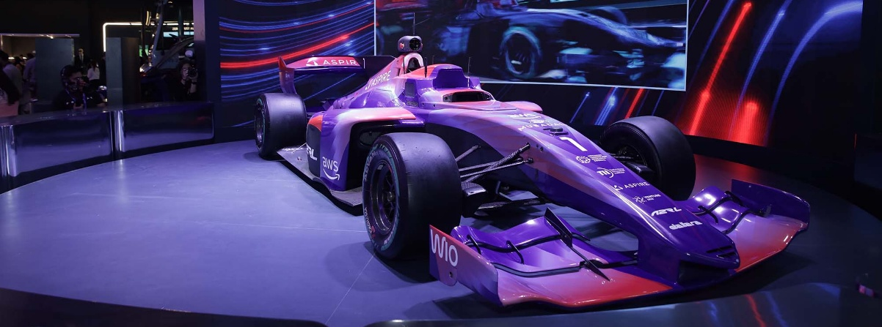

WHAT MAKES A GOOD TECHNOLOGY?
GOOD INTENTIONS
MUST be at the core of technologies to achieve beneficial outcomes
for society
Creators of tomorrow’s
technologies must prioritize societal
WELL-BEING, TRANSPARENCY, AND INTEGRITY IN THEIR WORK
Notes:
But remember – at the core of good technology lie GOOD INTENTIONS.
GOOD INTENTIONS MUST be at the core of technologies to achieve beneficial outcomes for society
Creators of tomorrow’s technologies must prioritize societal WELL-BEING, TRANSPARENCY, AND INTEGRITY IN THEIR WORK

Slide 21
WHAT PROFESSIONS DO WE NEED IN YOUR FUTURE?
Split into groups of 4 people + AI
Come Up
with
Top 7 professions of the future
Skills of the future
Present
Professions and skills
5 minutes
Notes:
INTERACTIVE: GROUP WORK

Slide 22


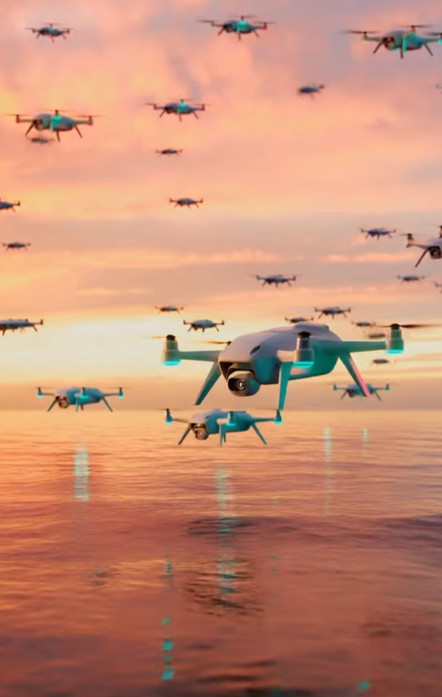
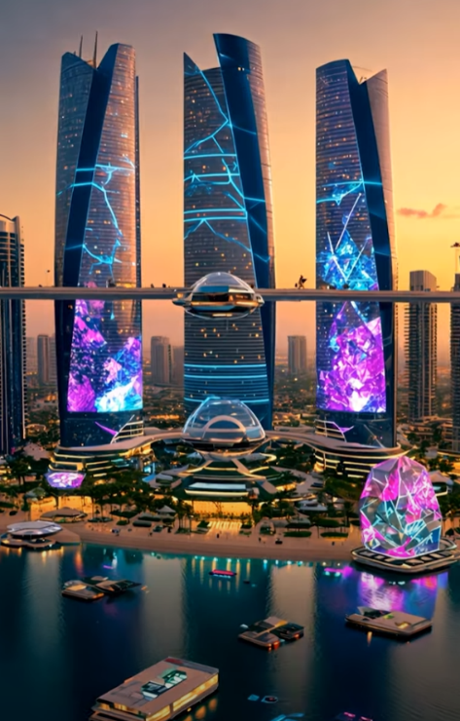
THE FUTURE TECHNOLOGIES ABU DHABI LEADERS FOCUS ON
Intelligence Age
SUPERINTELLIGENCE
HUMANOIDS
AUTONOMOUS ROBOTS
SMART TRANSPORT
Notes:
This is how Abu Dhabi Leaders imagine the technologies of the future. Not only imagine, but developing at ATRC. (Advanced Technology Research Council)
Technologies of the Intelligence Age: Superintelligence, Humanoids, Autonomous Robots, Smart Transport, and so on.
This is the vision for the next 5 years.

Slide 23






TOP FUTURE-FOCUSED TECHNOLOGIES
In the UAE and the World
Propulsion and Space
Autonomous Robotics
Advanced Materials
AI
Quantum
Making computers think and make decisions like people
Building super-fast computers to help with challenges that normal computers can not solve
Moving
rockets and satellites through space
Building cars, drones, robots, and humanoids that can work without people
Creating materials of the future – both for high-tech and
green-tech
Renewable
and Sustainable
Energy
Directed Energy
Secure Systems
Cryptography
Getting energy from sun, wind, water, and plants to be eco-friendly
Shaping the future of
electromagnetics and lasers
Keeping devices and networks autonomous and safe from hackers
Making secret codes to protect information – make sure it is you,
not your AI copy!
READ MORE
Notes:
When we are speaking about technologies of the future, these are the TOP FUTURE-FOCUSED TECHNOLOGIES in the UAE and the World.
You can read more about advanced technologies on ATRC webpage about Future-Focused Careers – scan the QR code and download the black Career Guide. It will tell you about advanced technologies, why they are important, and what to study.

Slide 24
WHO BUILDS THE FUTURE?
Notes:
But who builds the future?

Slide 25


TECHNOLOGY
Successful
Innovation =
+
TEAMWORK
COMMERCIALIZATION
Notes:
Successful Innovations always require two parts: good technology and good commercialization.
Technology should be easy to use and solve a problem. But it also needs to be commercialized, otherwise it would stay in someone’s garage / lab / laptop. People should hear about it, get interested, and be motivated to use.
Successful innovations require teamwork of those, who build technologies and who makes them used in the world.

Slide 26


WHICH CAREER PATH IS FOR YOU?
Who are we in this group? Scan the QR code and choose your Future Path
Can not scan? Use a hand technology and raise your hand!
Notes:
Let’s figure out what type you are and what would be your ideal path in innovating in advanced technologies.
Scan the QR code and take a test.
If it does not work – go to ATRC.GOV.AE/FFCP and find a test there

Slide 27

Take a short career test to see which path is for you! (part 1/2)
Choose (tick) up to 3 answers to each question
Your Pathway:
1
2
3
4
5
1. What excites you the most? | Discovering new things and conducting experiments | Building and designing new technologies | Solving complex mathematical problems | Creating innovative designs and products | Leading and managing projects
2. Which activity do you enjoy the most? | Reading scientific journals and articles | Coding and developing software | Analyzing data and statistics | Sketching and designing | Organizing and planning events
3. What is your favorite subject in school? | Physics, Biology or Chemistry | Computer Science or Engineering | Mathematics | Art or Design | Business Studies or Economics
4. How do you prefer to work on a project? | Independently or with like-minded people | Collaboratively, with a team of engineers | Analyzing data to find solutions | Creatively, brainstorming new ideas | Leading a diverse team and managing Tasks
5. What type of problems do you like to solve? | Mysteries of nature and the world around us | Technical Challenges | Mathematical puzzles | Design and usability issues | Organizational and logistical problems
Notes:
These are the questions you will see in the test (Part 1). Choose ALL answers that are relevant for you in each question. It can be one or several answers to the same question.

Slide 28
Take a short career test to see which path is for you! (part 2/2)
Choose (tick) up to 3 answers to each question
Your Pathway:
1
2
3
4
5
6. Which of these hobbies do you enjoy the most? | Reading science fiction & learning | Building gadgets or models | Playing strategy games | Drawing or crafting | Planning and organizing events
7. How do you approach a new task? | Research thoroughly before starting | Dive in and start building, experiment | Break it down into logical steps | Think creatively and outside the box | Plan and delegate tasks
8. What kind of books or movies do you prefer? | Documentaries or science fiction | Tech thrillers or engineering marvels | Mystery or detective stories | Creative and artistic films | Leadership and motivational stories
9. How do you handle challenges? | Research and experiment to find solutions | Use technology and tools to solve them | Analyze data and patterns | Think creatively and innovatively | Plan strategically and lead the team
10. What is your dream job? | Scientist or Professor | Engineer or Software Developer | Data Scientist or Data Analyst | Designer or Innovator | Project Manager or Team Leader
Number of ticks by columns
2
4
4
3
1
Pathways 2 & 3 suit you most
Notes:
These are the questions you will see in the test (Part 2). Choose ALL answers that are relevant for you in each question. It can be one or several answers to the same question. Then calculate all answers by columns. Which column has more answers ticked? This is your pathway / pathways

Slide 29
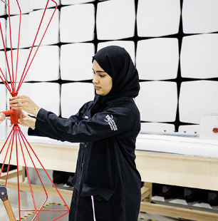
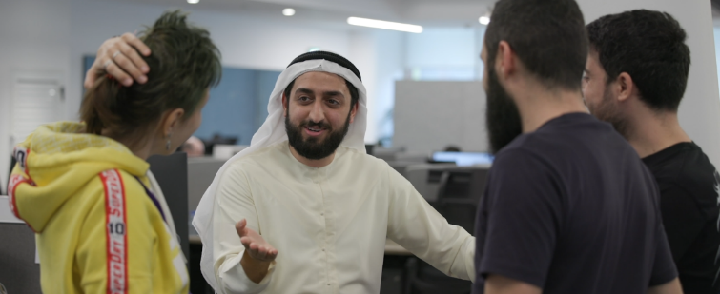
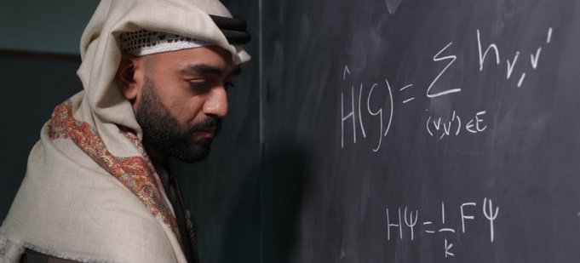
Researchers and Engineers
TECHNOLOGY
Build the Technologies of the Future
1
2
RESEARCHERS
ENGINEERS
Discover new knowledge and
understand how things work.
They prefer thinking and
discussing theories
Develop solutions to technical problems.
They prefer being practical,
building things and systems
Notes:
Let’s get to the results. First 2 pathways are for those, who would enjoy building the technologies. Researchers and Engineers. They understand all nuances of technologies. Some deeply focus on one technology, others work across several technologies.

Slide 30
Leaders, Creators, and Data Gurus
COMMERCIALIZATION
Make Invented Technologies USED in the World
3
4
5
DATA GURUS
CREATORS
LEADERS
Analyze data, identify patterns to make
informed decisions in
the world full of data
Business Analysts,
Data scientists,
Financial analysts
Develop innovative, convenient, and beautiful designs and communicate
it to the world
Marketing, Media
Manage teams and lead people and AI agents
to achieve the best results
on time and budget
Innovation Managers, Business, Government, Legal professionals
Notes:
3rd, 4th, and 5th pathways are for those, who commercialize technologies. Data gurus, creators, leaders. They do understand technologies, but not at a deep level. They communicate to the public, organize teams, analyze data to make decisions about big businesses or even nations.

Slide 31
HOW TO BECOME A RESEARCHER
OR ENGINEER?
TECHNOLOGY
SCHOOL
UNIVERSITY
WORK
Focus on Mathematics, Sciences, and English at School
Build your Profile from Grade 8!
  Develop leadership & teamwork skills
  Participate in STEM Events and Competitions
  Help Community, volunteer
  Engage in sports & arts
Study advanced technologies you are passionate about (AI, Quantum, Robotics, Cybersecurity, and others)
Take classes in climate change, ecology, food & agriculture, space studies, or healthcare
Work in teams and present your work! Emotional Intelligence is very important for researchers and engineers!
Build your portfolio. Take internships,
build systems of AI agents & human-machine collaboration
Find your Future-Focused Career
Practice, practice, practice!
Look for internships & take part in career events with researchers
and engineers
Follow ATRC in social media (@atrcuae in Instagram) and visit ATRC.gov.ae/FFCP
Notes:
(Info on the slide)

Slide 32
HOW TO BECOME A FUTURE LEADER, CREATOR, OR DATA GURU?
COMMERCIALIZATION
SCHOOL
UNIVERSITY
WORK
Focus on Mathematics and English
at School
Build your Profile from Grade 8!
  Develop leadership & teamwork skills
  Participate in co-curricular activities and Competitions
  Help Community, volunteer
  Engage in sports & arts
Specialize in Business, Economics, Mathematics & Statistics, Media, Management, Social Research, Philosophy, Law
Choose minors / take classes in climate change, ecology, food & agriculture, space studies, or healthcare or about technologies you are passionate about (AI, Quantum, Robotics, Cybersecurity, etc.)
Work in teams and present your work! Emotional Intelligence is highly important
Build portfolio: participate in student competitions, debate clubs, business case clubs, work on projects
Find your Future-Focused Career
Look for internships & take part in career events
Follow ATRC in social media (@atrcuae in Instagram) and visit ATRC.gov.ae/FFCP
Notes:
(Info on the slide)

Slide 33
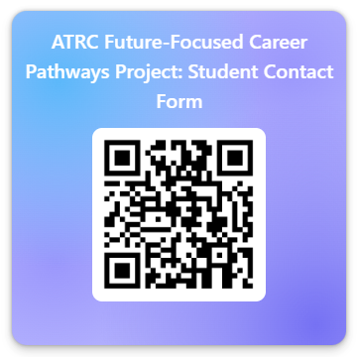
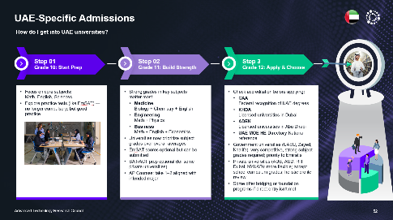
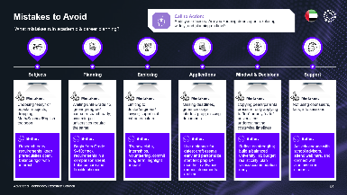
WHAT IS YOUR FUTURE PATHWAY?
INTERESTED IN FFCP MATERIALS?
Share contacts with us to
receive updates about Future-Focused
Career Pathways & Career Advice
https://forms.office.com/r/xveZ7mtT2i
Notes:
ATRC would love to know your results! Scan the QR code and share what pathway suits you most and some data. If you are interested in Future-Focused Career Pathways materials, share your email and choose “I do consent” to receive emails. They will send you a presentation about how to pick a university & career advice.

Slide 34
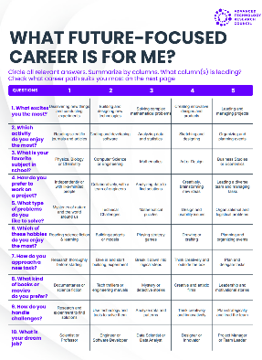

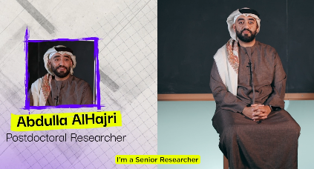

Learn more & Connect with ATRC
Future-Focused
Career Pathways
Webpage
www.atrc.gov.ae/ffcp/
Interviews with Researchers and Engineers
Career Test
Career Guide
ATRC WEBSITE
www.atrc.gov.ae
SUBSCRIBE ON
INSTA & LINKEDIN
@atrcuae
Notes:
Here are some links.
At atrc.gov.ae/ffcp you will find a career test, guide, and interesting interviews with researchers and engineers working at Robotics, Quantum, and Propulsion Research centers at Technology innovation Institute.

Slide 35
THANK YOU!
ATRC Team

Slide 36


FOR CAREER COUNSELORS
Please fill in to participate in the Future-Focused Program & Leave Feedback
Your participation is highly appreciated!
Future-Focused, Future-Ready
https://forms.office.com/r/6KJg4uGLVw
Notes:
To Career counselors: Thank you for your amazing work! Please fill in the short questionnaire about the workshop results – we would love to meet you one day!
ATRC Team

Slide 37
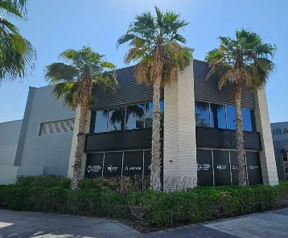


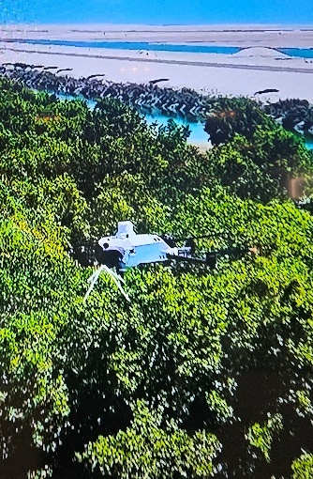
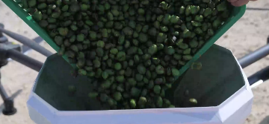


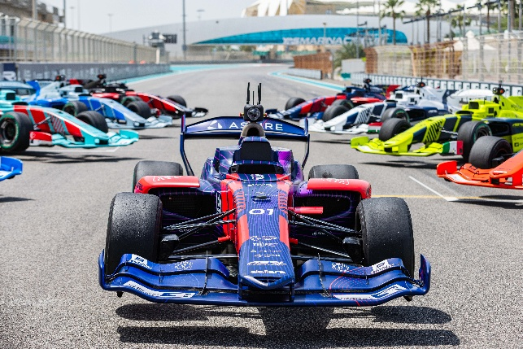

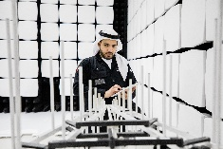
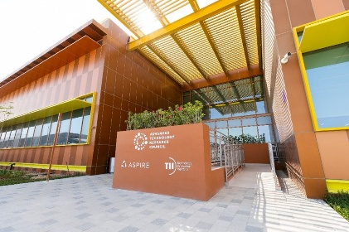
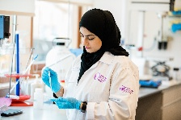
Facts about ATRC
Established in 2020 in Abu Dhabi
WE HAVE
OUR OFFICES
OUR LARGEST TECHNOLOGIES
ATRC HQ – Yas Island
AI: Open-Source Falcon LLMs
Drones: Restoration of mangrove ecosystems with autonomous drones
1400+
Researchers, Engineers, Managers and others
90
Nationalities
A2RL – Autonomous Racing League
TII – Masdar City
9 Research
Centers
in Abu Dhabi
And more
Advanced Technology Research Council

Slide 38
About ATRC workshop
“WHO BUILDS THE FUTURE?”
Built to be interactive! Not a lecture. We create a space for students to share bold ideas, be creative, and inspire them to build a good future!
Length can be adjusted by different time dedicated to exercises
Suits all students from Grade 8 to Grade 12 (STEM & non-STEM)
All you need to know is in PowerPoint. Comments to the slides are added as notes.
No special knowledge about Advanced Technologies is required from you – if any questions, refer to the guide / FFCP website (https://www.atrc.gov.ae/ffcp) Career tests and Career Guide about advanced technologies are available in this website
We welcome your feedback and will be happy to hear how the workshop went! Use QR and motivate students to use QR codes to get in touch.
This program is counted towards your professional development and you will get a certificate upon delivering a workshop to the students (we will need students’ responses and your response to the questionnaires by QRs in the training)

